Slide 1
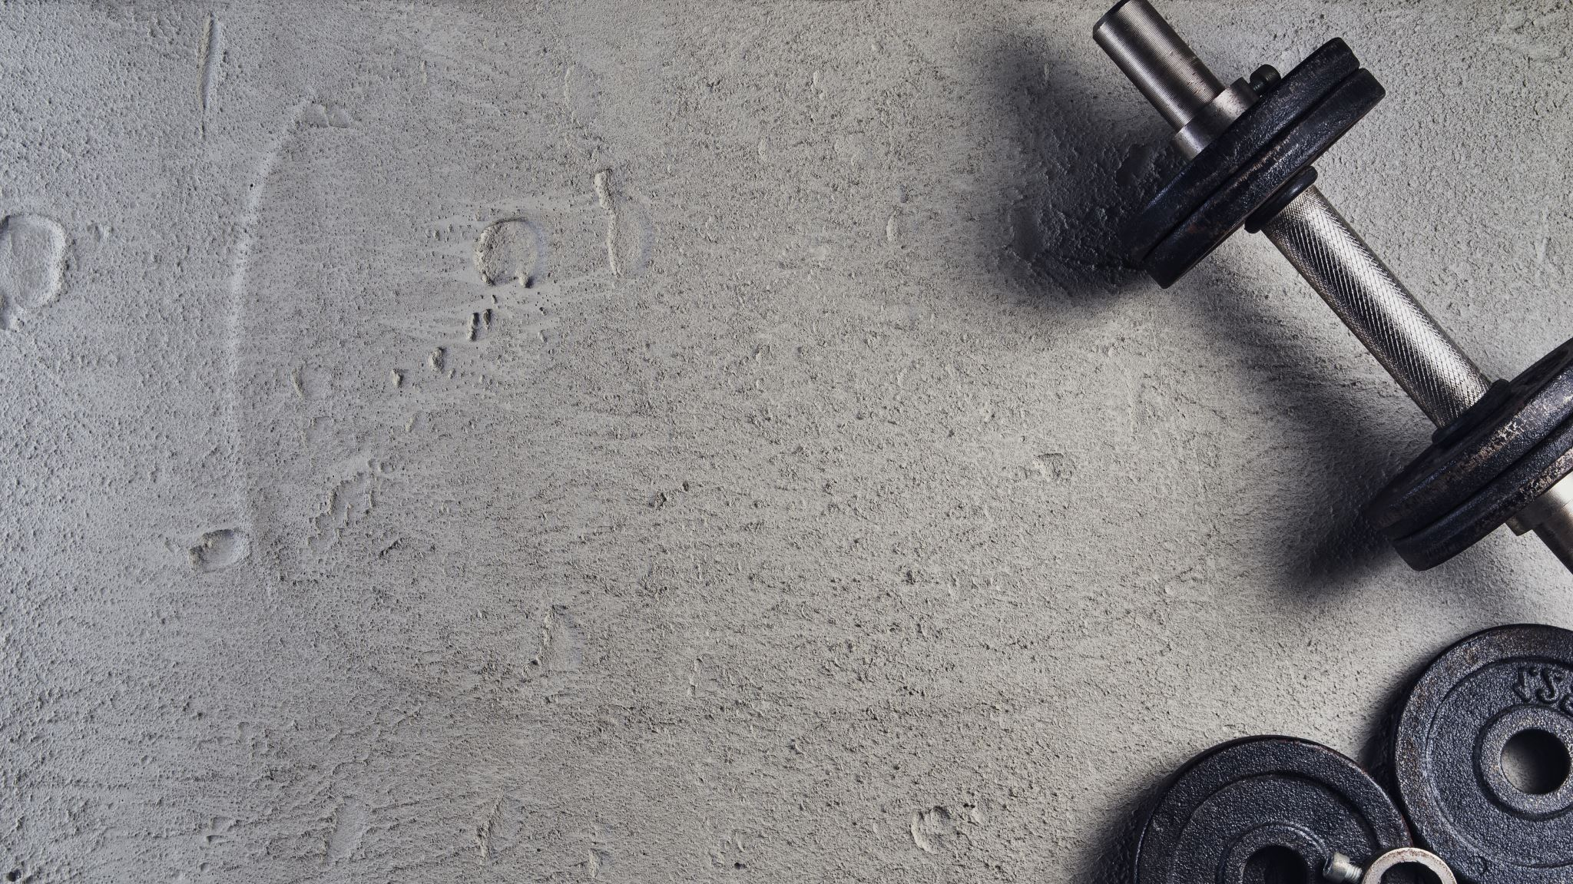
Python Capstone: Sports Nutrition
By Bodhi Hungerford

Slide 2
What is Sports Nutrition?
“The study and practice of nutrition and diet with regards to improving anyone’s athletic performance”
Who does it reach?
What are the products?
What will we be looking at?
Whey v. Plant Protein
Categories, Price, Rating

Slide 3
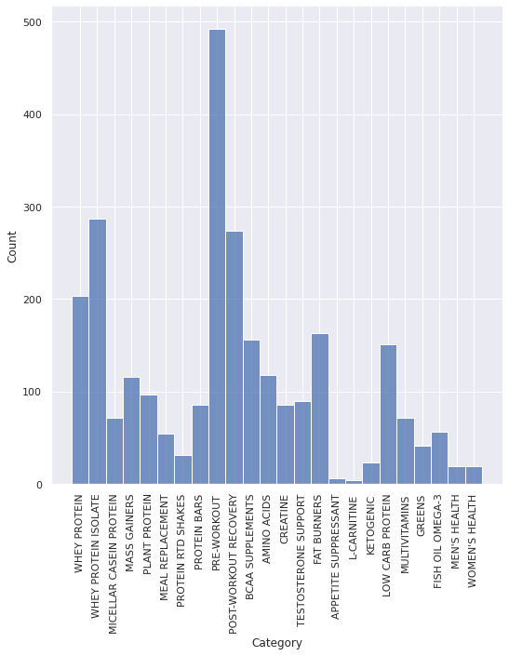




Slide 4
Categorys
Top Three
Pre-workout/Post-Workout
770
Protein(Whey Isolate, Whey, Plant)
600
Fat-Burners
170

Slide 5
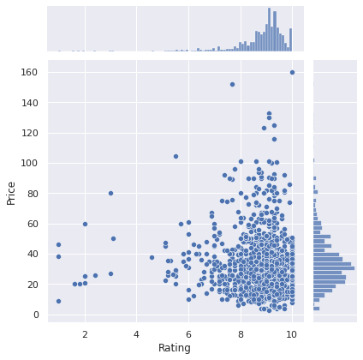


Slide 6
Ratings + Price
Ratings mostly >8.0
Mode:9.33
Price mostly<$60
Mode: $20-$40

Slide 7
Hypothesis
“My hypothesis is if Plant Protein and Whey Protein are considered comparable, then Plant Protein will be a little more expensive and a little lower rated.”
Take 30 seconds to make your own prediction(remember the three categories)

Slide 8
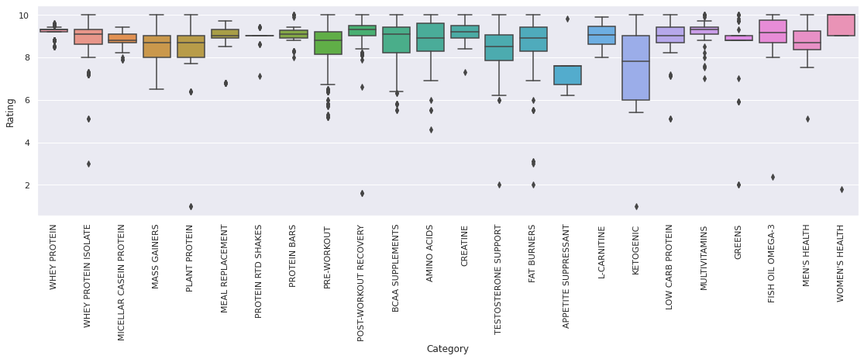
Rating per Category

Slide 9
Ratings per Category
Observations
“Whey Protein" barplot: condensed
“Plant Protein” barplot: variance
Anything else we can gather from data?
Ratings generally High
(explore: highest ceiling/lowest floor , outliers)

Slide 10
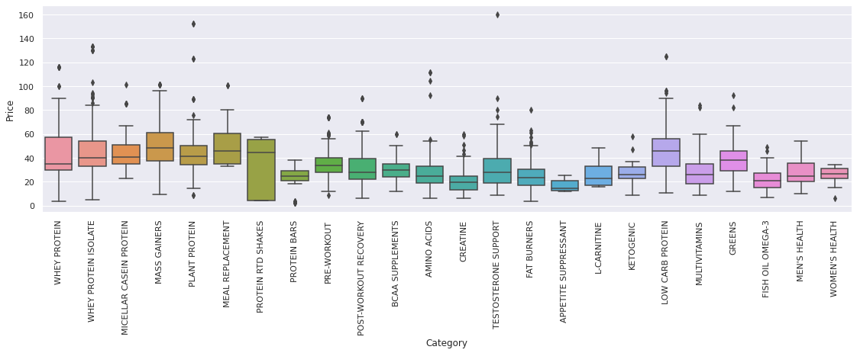
Price per Category

Slide 11
Price per Category
The Bars are all Lower!!
Why?
Large Medians v. Small Medians

Slide 12
Description and Correlation
Description
Correlation
 | Rating | Price
count | 2719 | 2719
mean | 8.81 | 36.16
std | 0.946 | 18.994
min | 1.00 | 2.39
25% | 8.6 | 23.99
50% | 9.0 | 32.99
75% | 9.3 | 44.99
max | 10.0 | 159.99
 | Rating | Price
Rating | 1.00000 | -0.01748
Price | -0.01748 | 1.00000

Slide 13
Description and Correlation
What are we looking at here?
mean, std, max, min and percentiles, column count
How is this useful?
'Ratings' parameters more constrained
Rating and Price; negligible correlation

Slide 14
Price: T-test results
T-statistic=1.354
p-value=0.1768
The difference in means at the 95% confidence interval (two-tail) is between -10.188 and 1.985

Slide 15
Rating: T-test results
T-statistic=-7.202
p-value=4.864e-12
The difference in means at the 99% confidence interval (two-tail) is between 0.439 and 0.985.

Slide 16

T-test analysis
Within Same Price Levels, Whey’s Rating>_>Plant’s Rating
Was I right?
Plant protein is about the same price as whey but considerably less liked.

Slide 17
Conclusion
Insights?
Further research

Slide 18
Links
Sports nutrition supplements with ingredients | Kaggle
Data source
Google Colab Notebook
Python workbook
Sports nutrition – Wikipedia
Definition

